Slide 1
Breadth-First Traversal
CS570 - Big Data Processing & Analytics
Submitted by: Divya Pandey(19665)
Instructor: Dr. Henry Chang

Slide 2
Table of Content
Introduction
Design
Implementation
Test
Enhancement Ideas
Conclusion
References

Slide 3
Introduction
The breadth-first search or BFS algorithm is used to search a tree or graph data structure for a node that meets a set of criteria.
In BFS, we traverse one level at a time and then jump to the next level.
The BFS algorithm makes use of the queue data structure for implementation.
In BFS, we always reach the final goal state

Slide 4
Design
The ball can go through the empty spaces by rolling right, left, up, down
It won't stop rolling until hitting a wall
When the ball stops, it could choose the next direction.
The Search Sequence is Right ==> Left ==> Top ==> Bottom

Slide 5
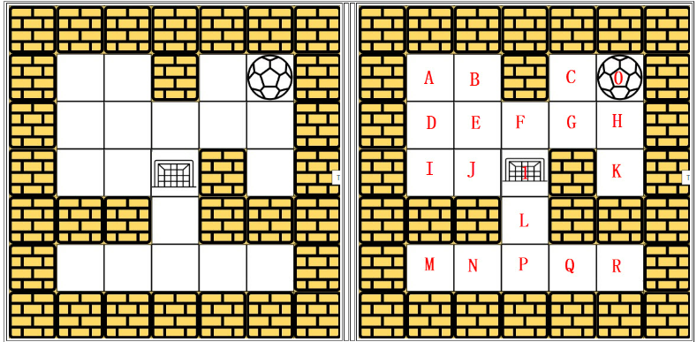
Design
Maze = [[0,0,1,0,0], 0→ Empty, 1→Wall
[0,0,0,0,0],
[0,0,0, 1,0],
[1, 1,0, 1, 1],
[0,0,0,0,0]]
Start: [0,4]
Destination: [2,1]

Slide 6
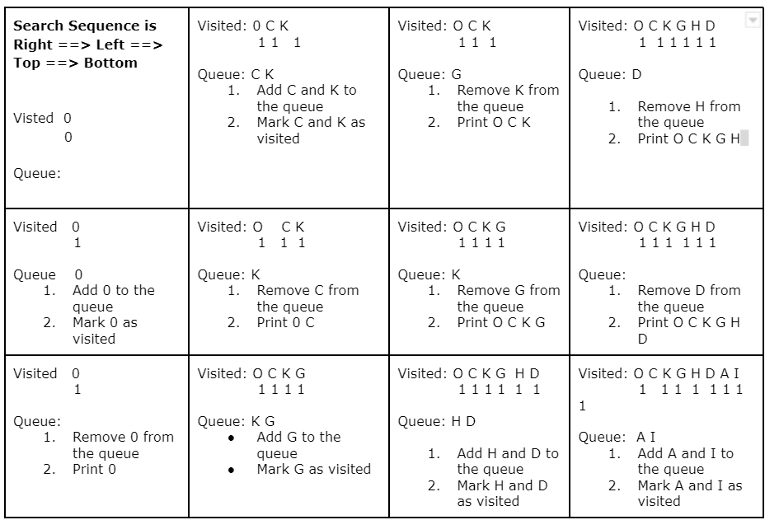
Design

Slide 7
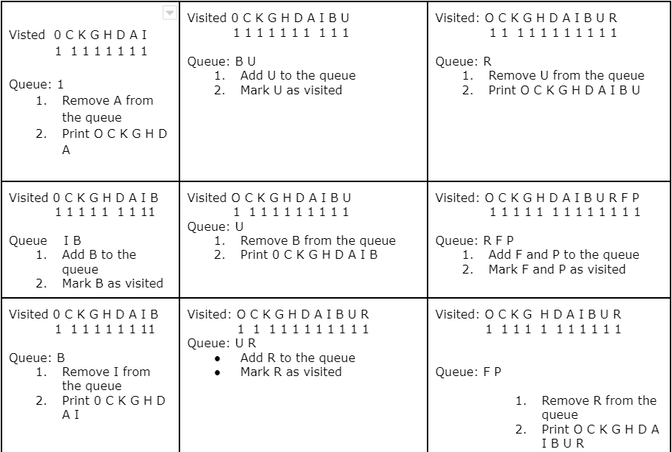
Design
=

Slide 8
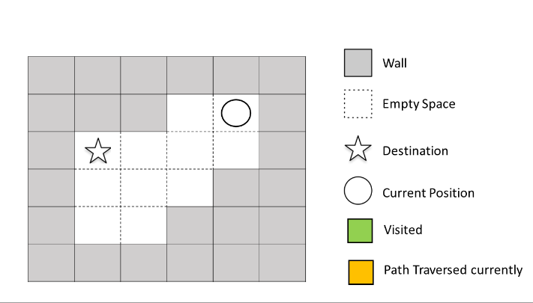
Design
The ball can go through the empty spaces by rolling right, left, up, down

Slide 9
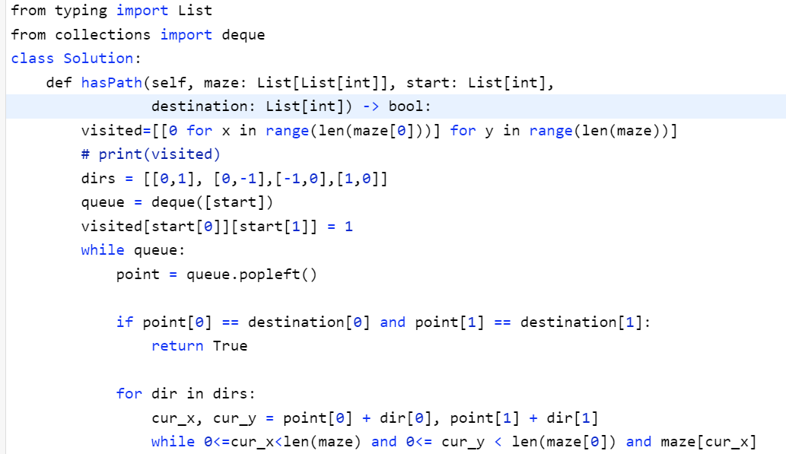
Implementation
Download bfsmaze.py program.
Python3 bfsmaze.py (Ubuntu)
Or you can run this program into visual Studio

Slide 10
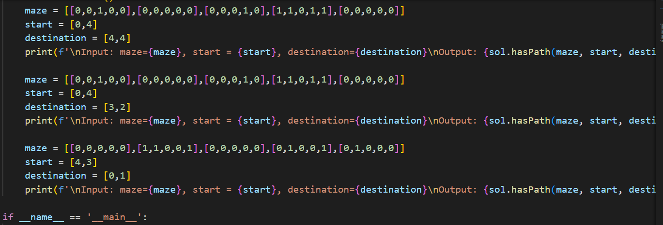
Test Case

Slide 11
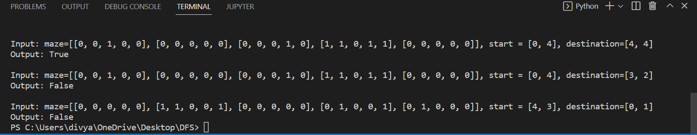
Test Result

Slide 12
Enhancement Ideas
Find the shortest path from Depth First Traversal and solve the maze problem
Adding new BFS algorithm (forward and reverse) for finding full paths in order to find for a certain node

Slide 13
Conclusion
We have gone through a graph traversal technique known as BFS. we have seen the working of BFS and its implementation via python programming language.
Time complexity: Since we are visiting all the nodes exactly once, therefore, the time complexity is O(V+E). Here, O(E) may vary between O(1) and O(V2). Thus, in the worst case, the time complexity of BFS is O(V2).
Space complexity: The space complexity of the BFS algorithm is O(V) where V denotes vertices/nodes of the graph.

Slide 14
References
Benha University Follow. (n.d.). Algorithms lecture 7: Graph algorithms. Share and Discover Knowledge on SlideShare. Retrieved November 13, 2022, from https://www.slideshare.net/mohamedloey/algorithms-lecture-7-graph-algorithms
Team, T. V. (2021, September 16). Breadth first search in data structure. TechVidvan. Retrieved November 13, 2022, from https://techvidvan.com/tutorials/breadth-first-search/

